Slide 1
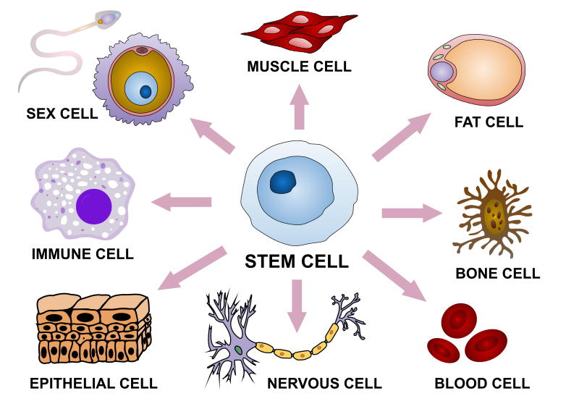

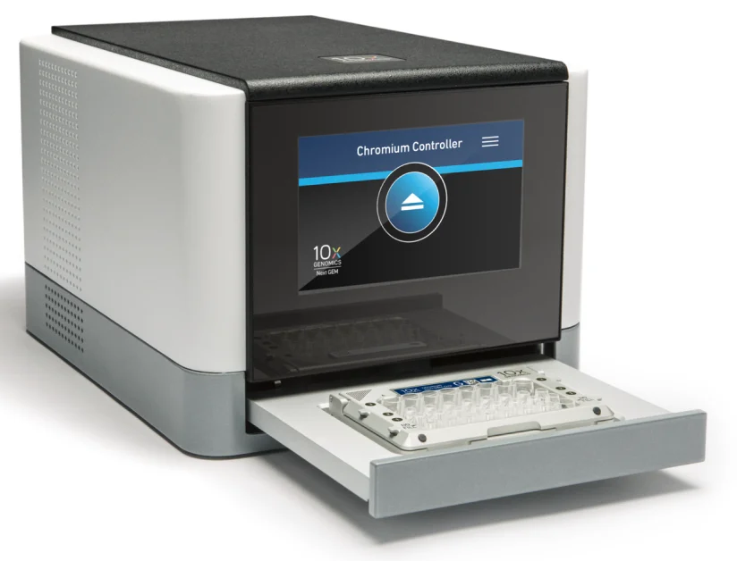
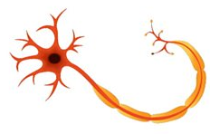
SINGLE-CELL RNA SEQUENCING TECHNIQUE
------What is SINGLE CELL and why does it matter??

Slide 2
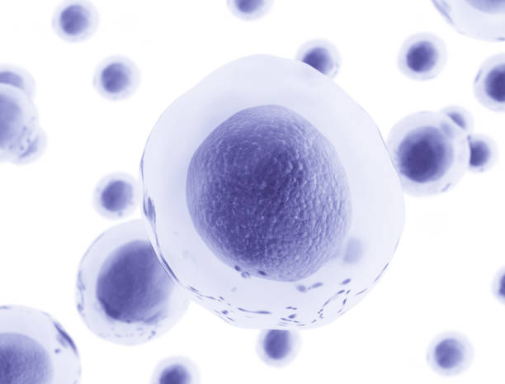
Biology is Immensely Complex
40 trillion cells in the human body
Each with its own set of expressed genes
Enormous complexity within each cell
Interactions of millions of different molecules and molecular machines
Cells form tissues, which form organ
Each tissue with a large diversity of cells and cell types

Slide 3
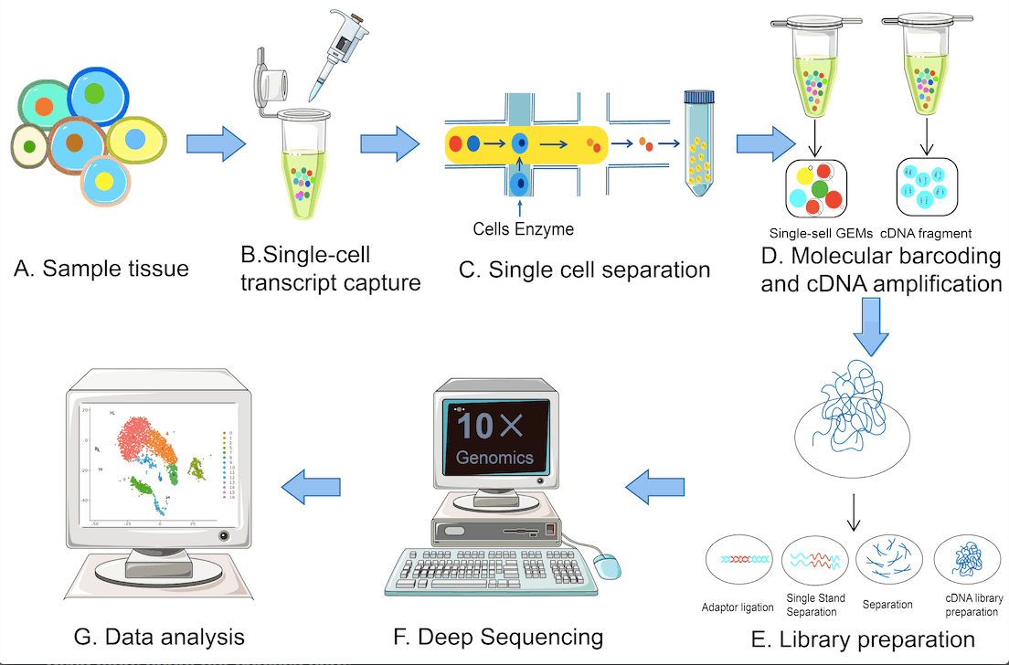

Slide 4
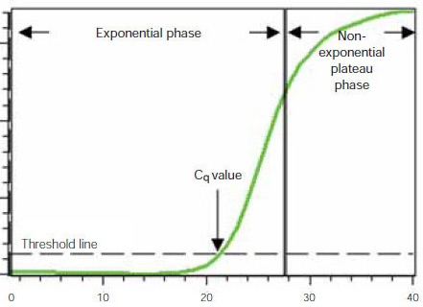
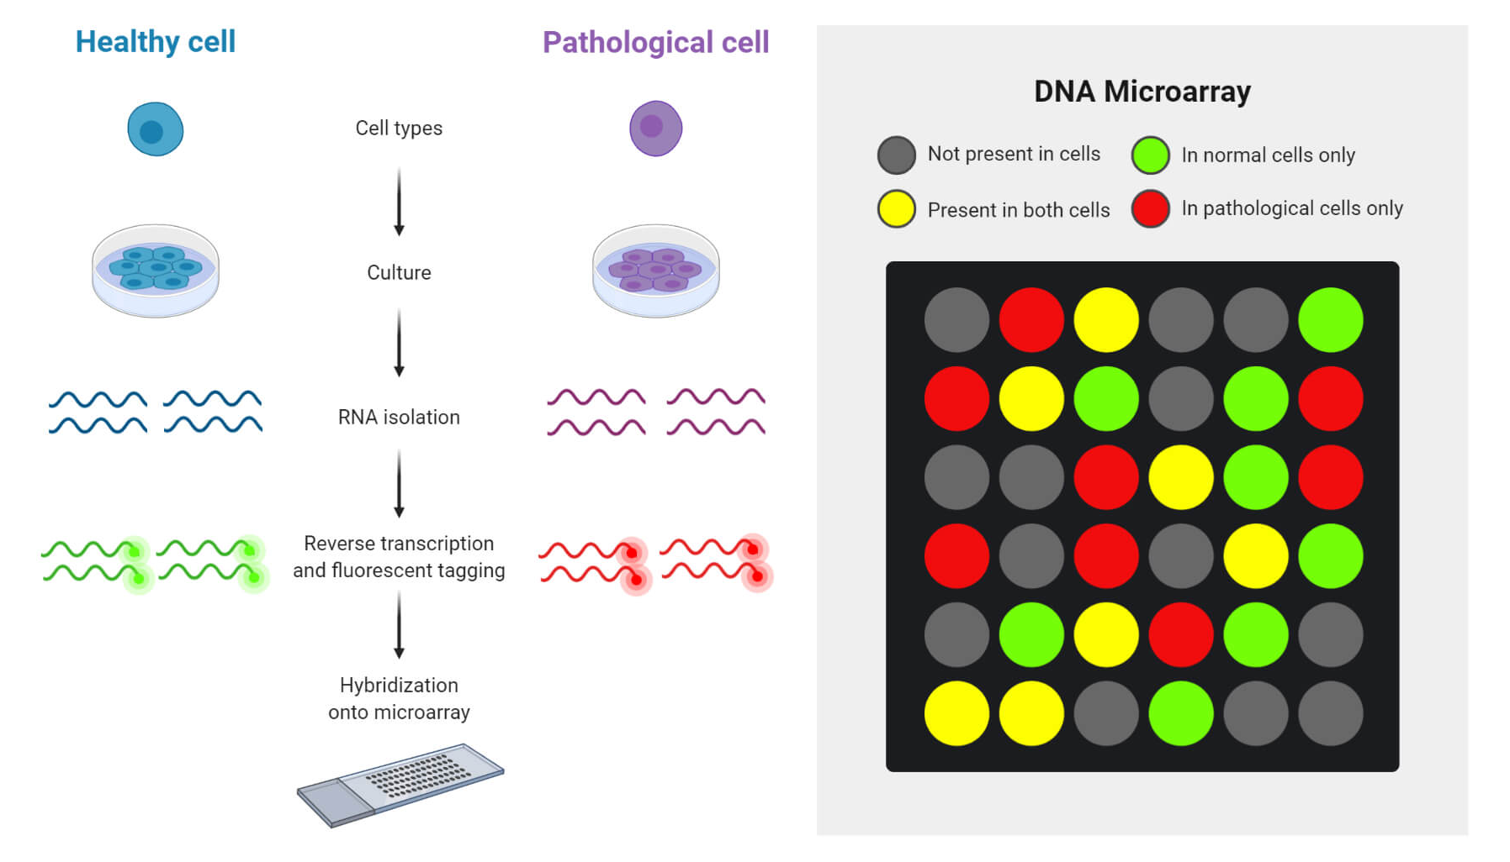
A quick glance at more traditional Technologies
qPCR
Microarray

Slide 5
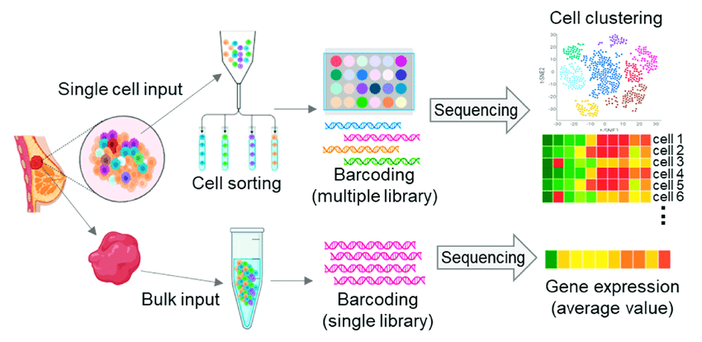

Slide 6
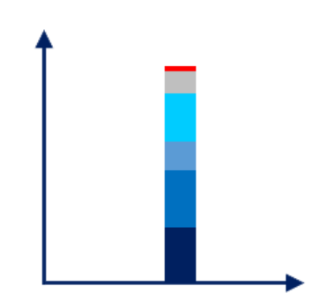
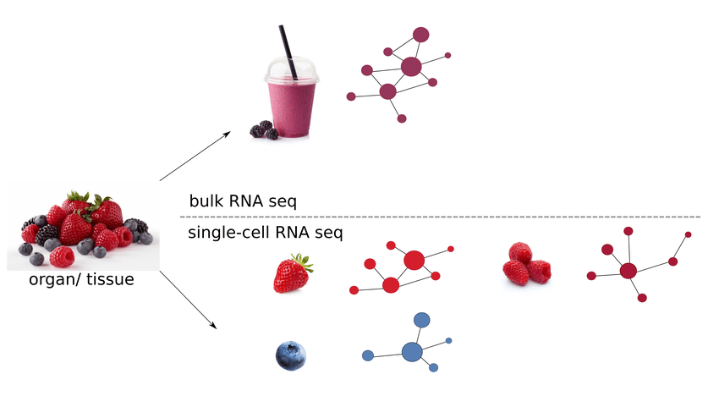
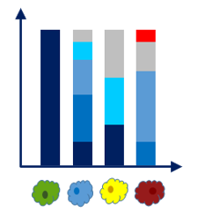
Bulk vs Single Cell RNA Sequence
Cell type-specific gene expression is masked
Each cell has a distinct expression profile

Slide 7
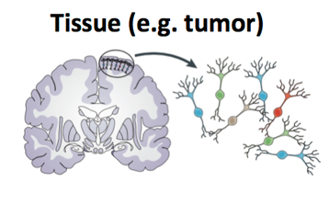
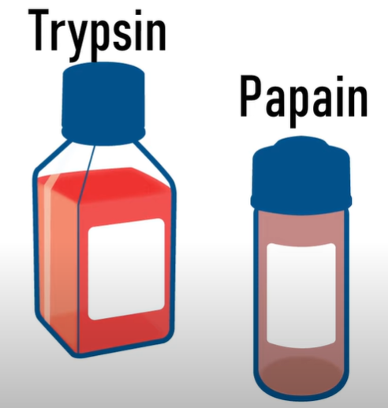
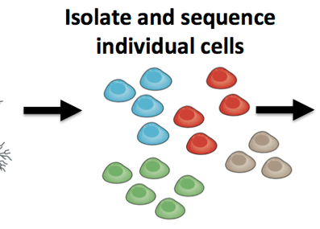
Step 1: Formation of Single Cell Suspension
Tissue with Heterogeneous Cell types
Formation of Single Cell Suspension
Dissociated with Trypsin or Papain

Slide 8
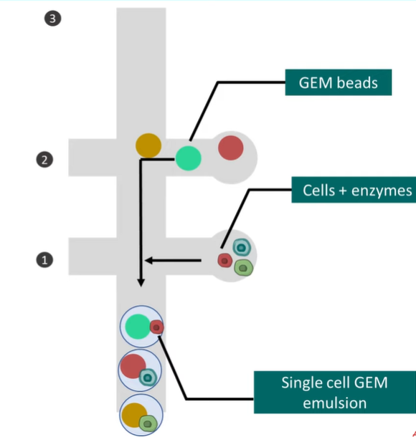
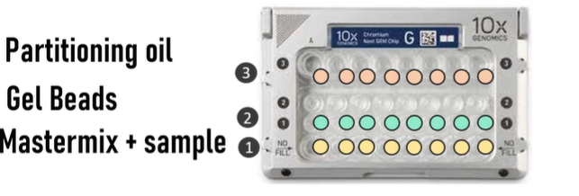
Step 2: Making Emulsions with GEM Bead
Chromium microfluidics chip
Combined on a microfluidic chip to form a reaction vesicle called
Single-cell GEM emulsion
1. Single Cells
2. Reverse Transcription Reagents
3. Gel beads Containing barcoded oligonucleotides
4. Oil

Slide 9
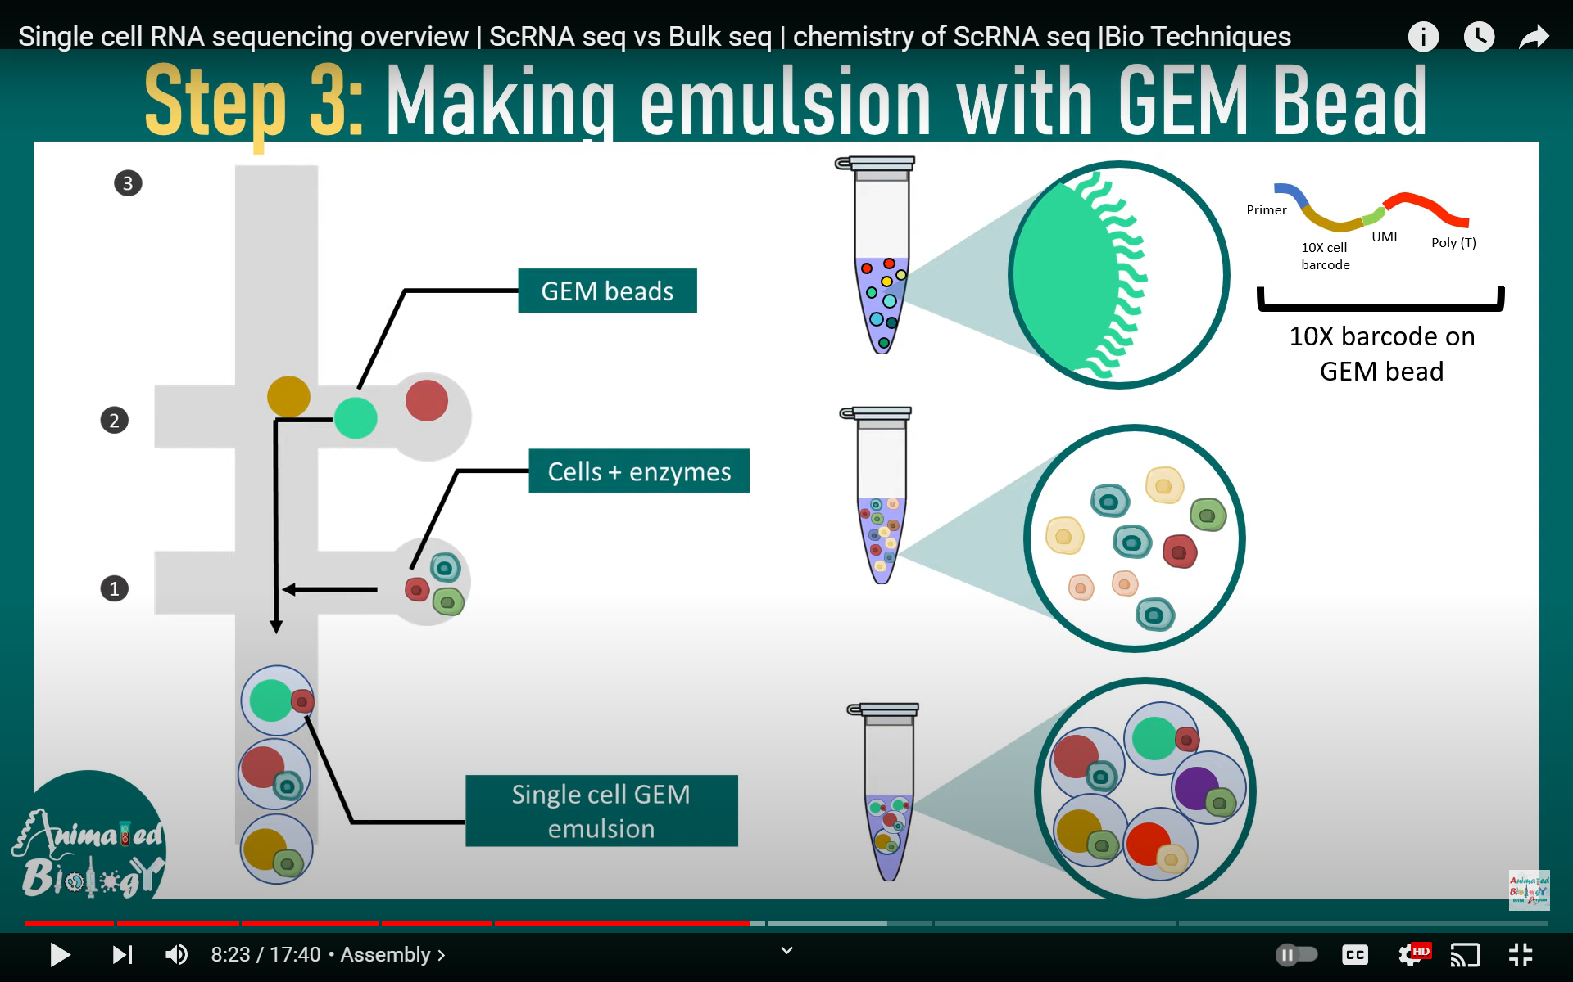
Captures mRNA that comes from the cell

Slide 10
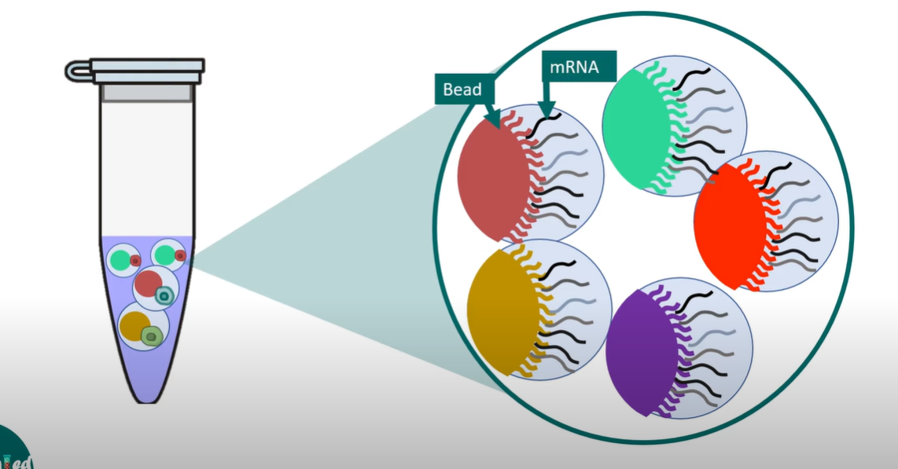
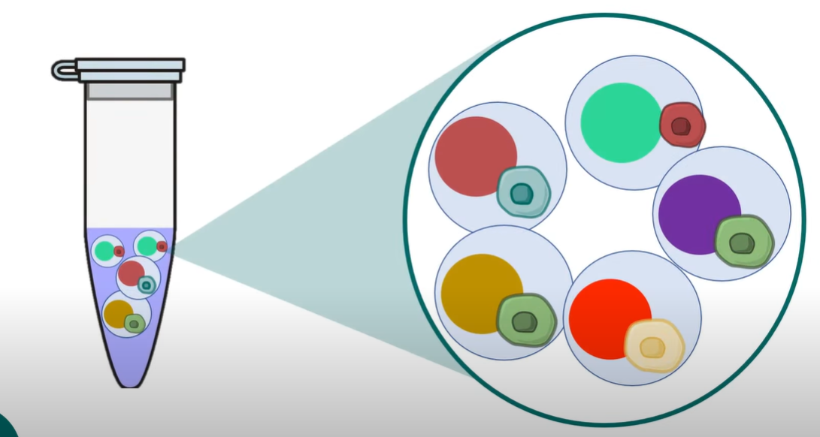
Step 3: Breaking the emulsion GEM Bead

Slide 11
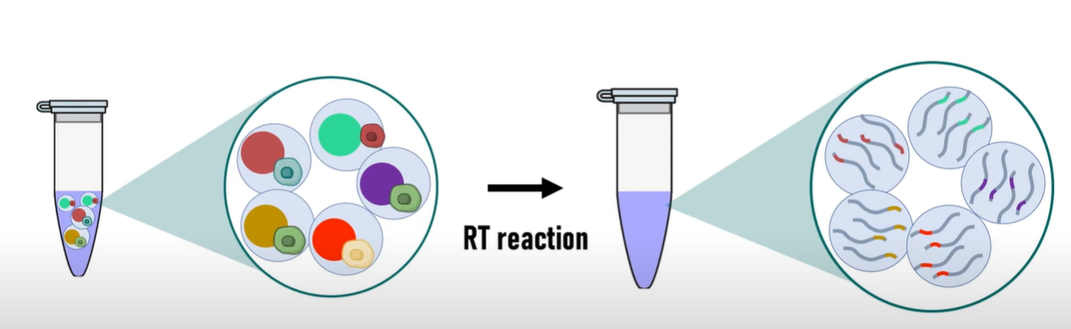
Sequences with the same barcode can be grouped together as they are coming from same cell source

Slide 12
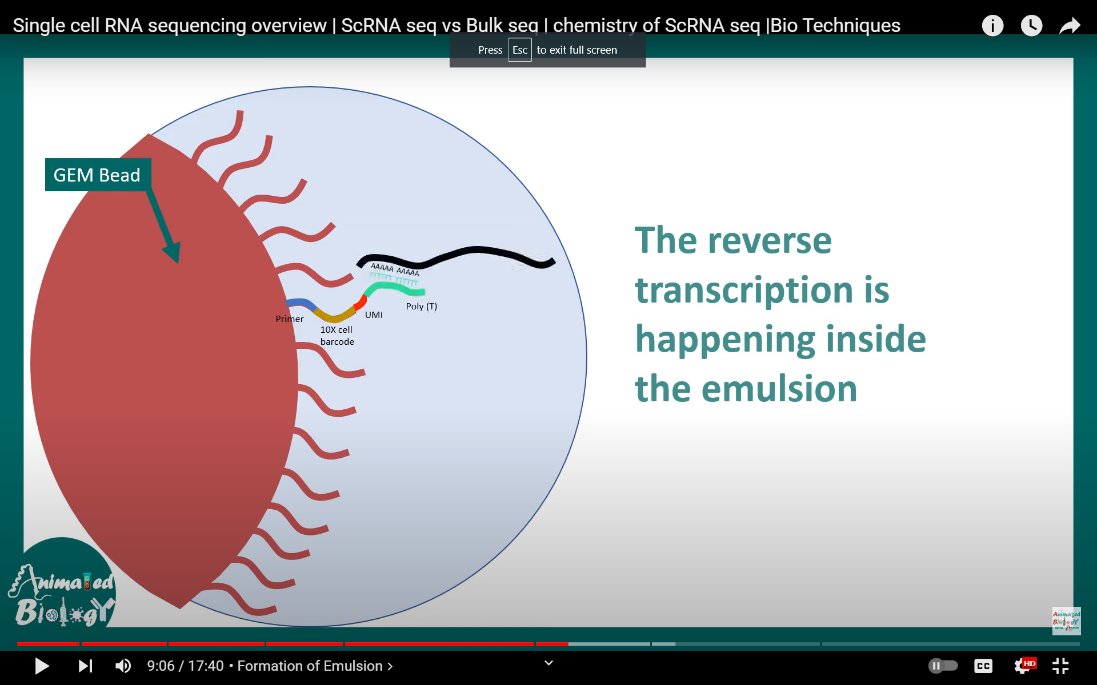
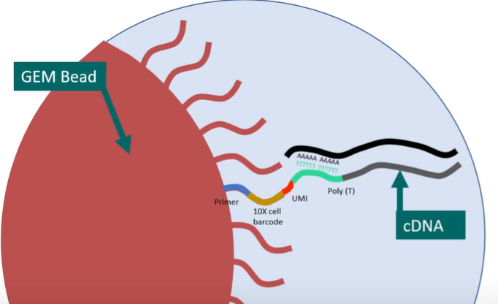
Reverse Transcription happening inside the Emulsion

Slide 13
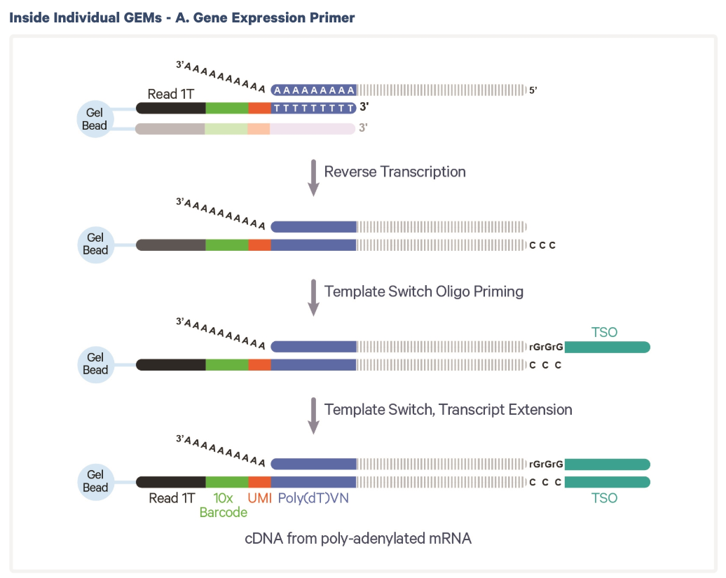

Slide 14
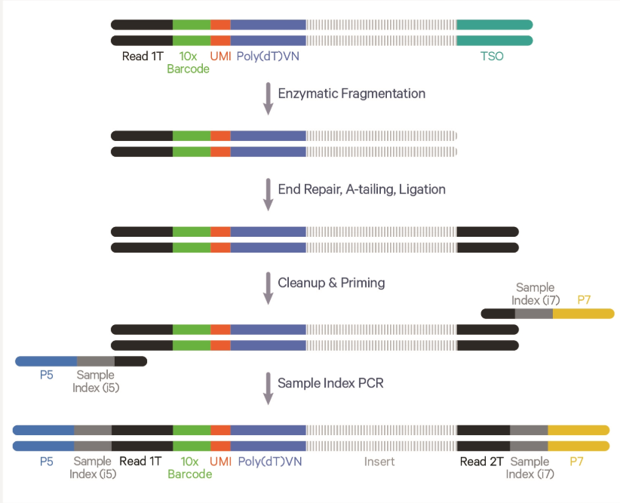
Step 4 Library Preparation
Read By a Sequencer

Slide 15
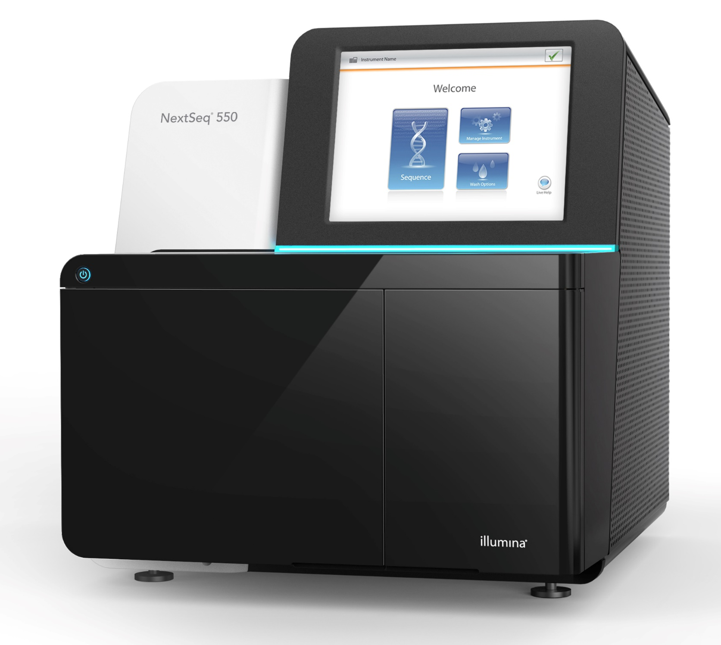
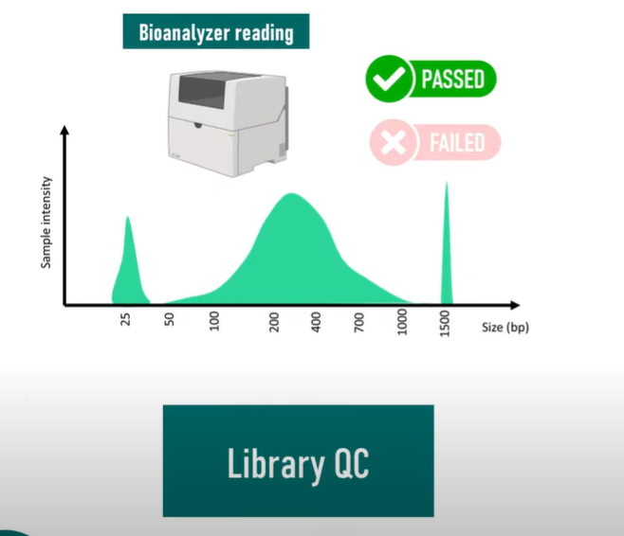

Step 5 Library QC and Sequencing
Loaded onto a Sequencer
READS
Passed Library QC

Slide 16
FASTQ Files
Read Processing & quantification
QC & Filtering
Data Integration
Single-cell gene expression – Data Analysis Summary
Down Stream Analysis
Cell Type Annotation
Differential Gene expression analysis
Clustering & Visualization

Slide 17
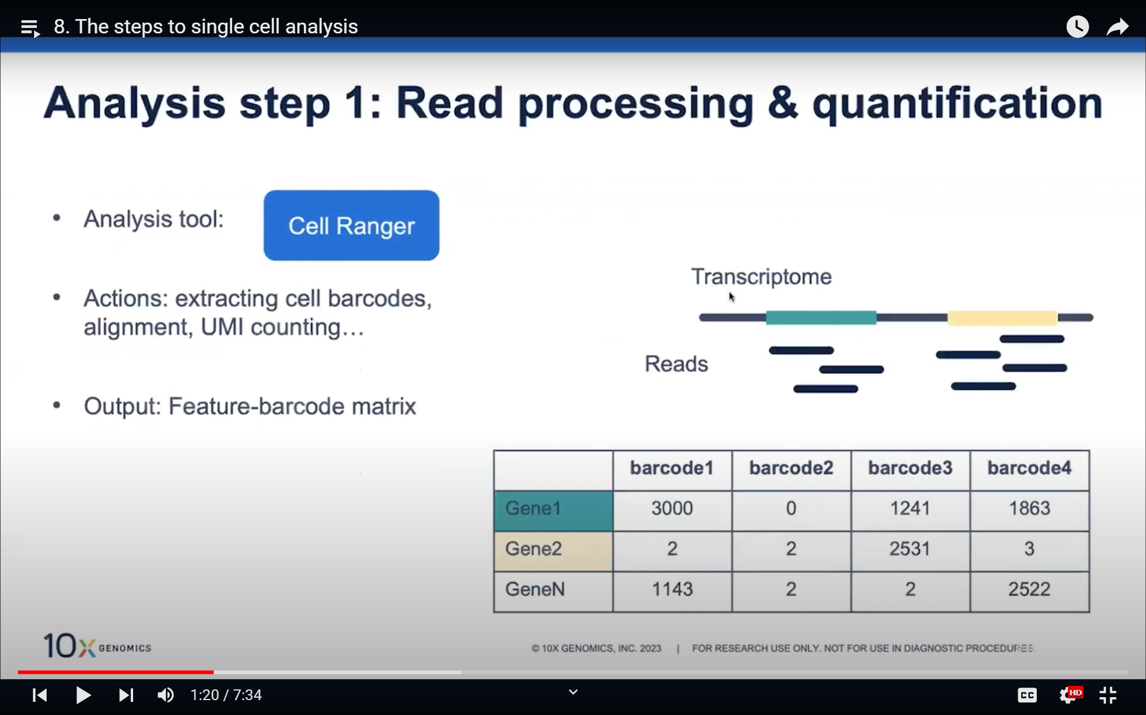
1. Read processing and Quantification
Analysis tool – CELL RANGER
Process – Extracting cell barcodes, alignment, UMI counting
Output --- Feature barcode matrix

Slide 18
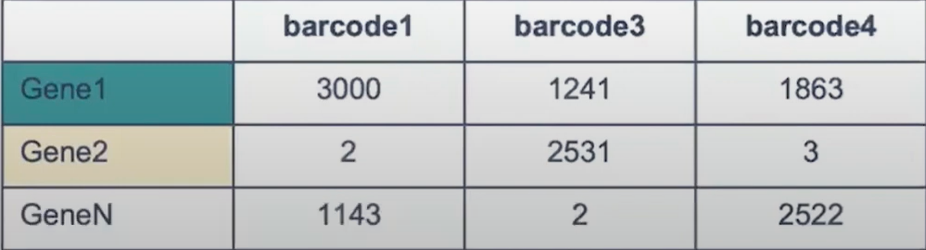
2. QC & Filtering
Analysis tools – CELL RANGER & LOUPE
Process – Detecting cell-associated barcodes
Checking mapping and sequence qualities
Filtering cell barcodes based on a number of features, reads, etc..
Output --- Filtered barcodes

Slide 19
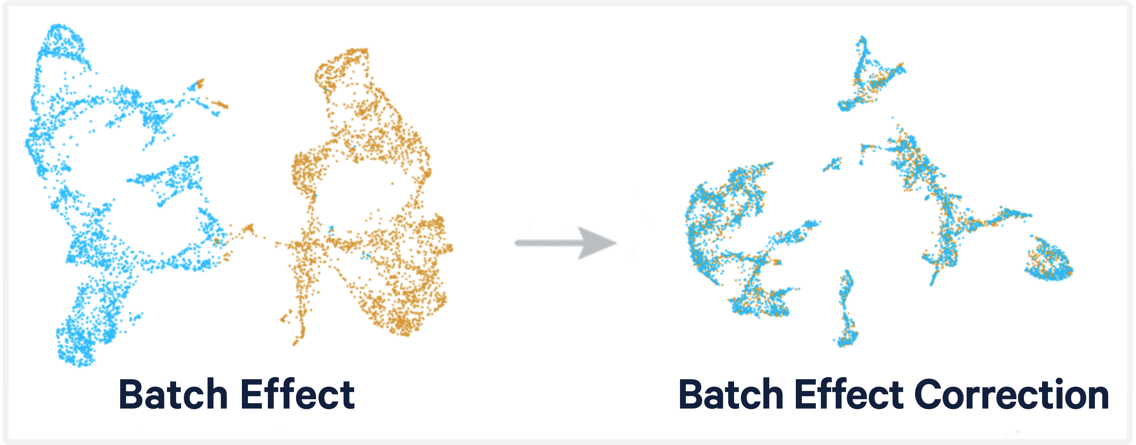
3. Data Integration
Analysis tools – CELL RANGER & Community Developed tools
Process – Integrate Multiple samples and correct potential batch effects
Output --- Corrected, Integrated Data

Slide 20
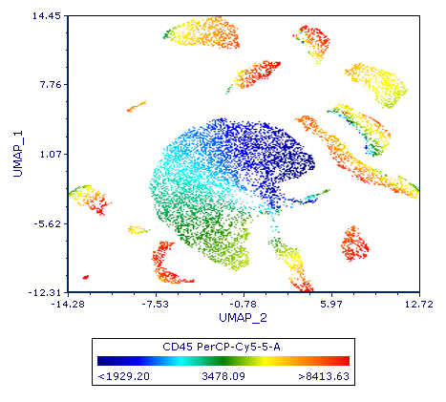
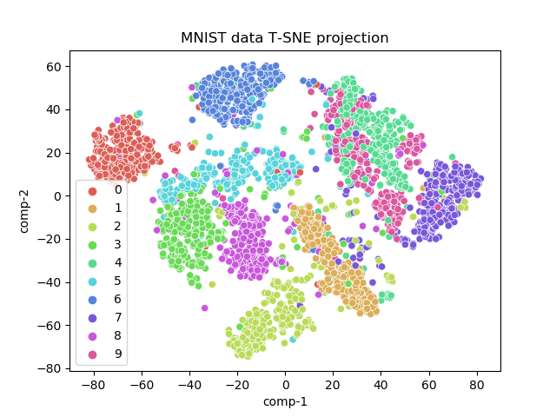
4. Clustering and Visualization
Analysis tools – CELL RANGER
LOUPE
Community Developed tools
Process – Group similar cells into clusters and Visualize using tSNE or UMAP
Output --- Cells in clusters and two-dimensional tSNE or UMAP plot

Slide 21
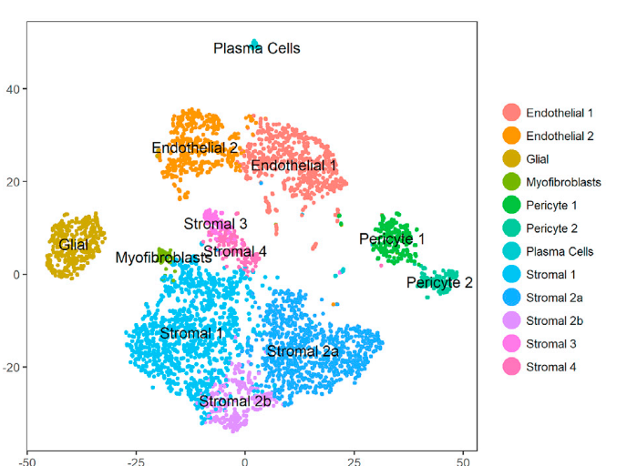
5. Differential Gene Expression Analysis
Analysis tools – CELL RANGER
LOUPE
Community Developed tools
Process – Perform differential gene expression analyses for each cluster vs the rest of the cells
Output --- List of enriched genes (markers) in each cluster, with logFC and P values
6. Cell type annotation
Process – Annotate cell clusters based on enriched markers or a reference dataset
Output --- Annotated cell populations

Slide 22
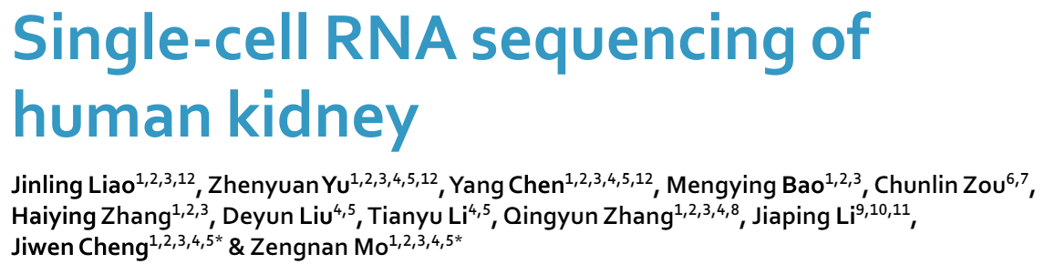

Objective: The study aimed to understand the cellular composition and transcriptomic profiles of the human kidney to provide insights into renal diseases and cancer.
Fresh human kidney samples were obtained from patients undergoing radical nephrectomy and radical nephroureterectomy. Normal kidney tissues were collected at least 2 cm away from tumor tissue.
Used 10x Genomics Chromium platform for single-cell RNA sequencing
scRNA-seq data was generated for 23,366 high-quality cells from three human kidney donors.
Identified 20,308 PT cells, highlighting their abundance in the dataset. Classified PT cells into three distinct clusters based on their molecular markers: proximal convoluted tubule, proximal straight tubule, and a group with no accurate classification

Slide 23
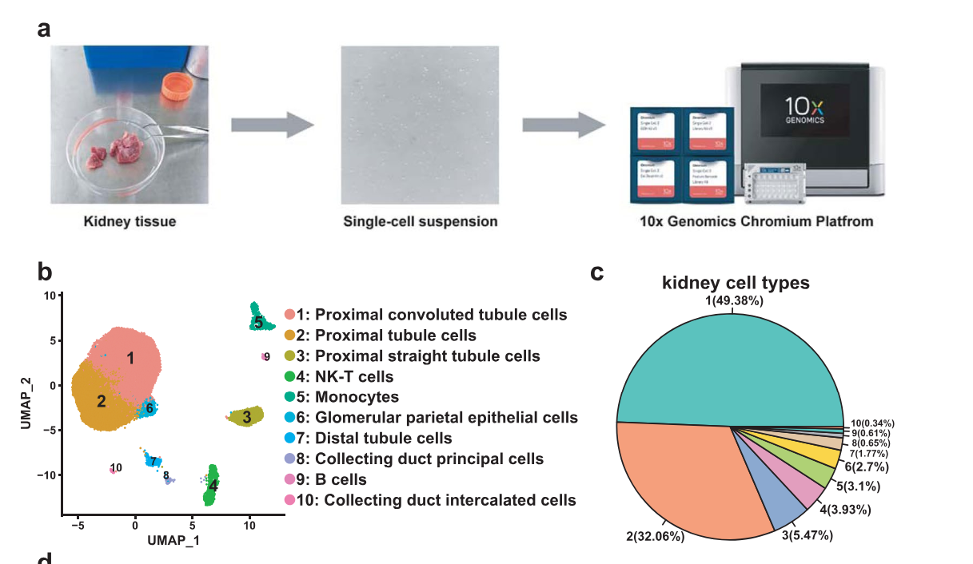
Findings:
Characterization of Proximal Tubule (PT) Cells
Characterization of Collecting Duct Cells
Confirmation of Data Validity
Detailed Classification of Cell Subsets
The study identified 10 clusters of normal human renal cells. Subtypes within proximal tubule (PT) cells (three subtypes) and collecting duct cells (two subtypes) were characterized.
The data provided detailed transcriptomic information at the single-cell level, allowing for the identification of specific gene expression patterns within different cell types.
Clustering analysis identified 10 distinct cell types and differentially expressed genes were identified for each cell type.

Slide 24
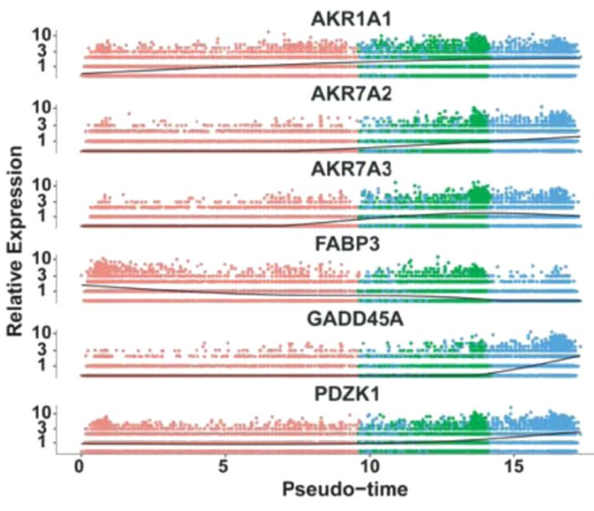
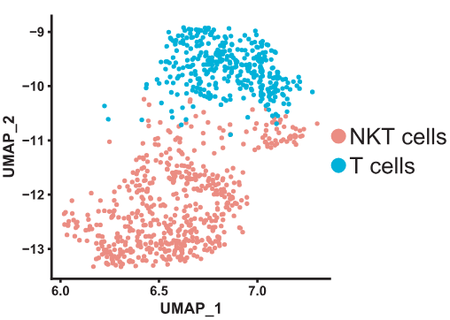
The top six genes influencing fate decisions are shown as line plots displayed as the expression level over pseudo time by Monocle2
Classified collecting duct cells into principal cells and intercalated cells according to marker expression
Cluster 4 highly expressed marker genes of both NK cells and T cells, designated as NK-T cells
By modifying the parameters cluster 4 can be further classified into two subtypes NKT cells (characterized by specific genes like CD3D, CD3E, GNLY, and NKG7) and T cells (characterized by genes like CD3D, CD3E, and IL7R).

Slide 25
REFERENCES
https://www.10xgenomics.com/blog/single-cell-rna-seq-an-introductory-overview-and-tools-for-getting-started
https://youtu.be/eVEDw1YykME?si=ElAcmdANkj4_R5mE
https://www.10xgenomics.com/support/single-cell-gene-expression/documentation
file:///C:/Users/admin/Downloads/CG000732_ChromiumGEM-X_SingleCell3_ReagentKitsv4_CellSurfaceProtein_UserGuide_RevA.pdf
https://www.nature.com/articles/s41597-019-0351-8

